Slide 1
Mediator Design Pattern
By Ezell Frazier

Slide 2
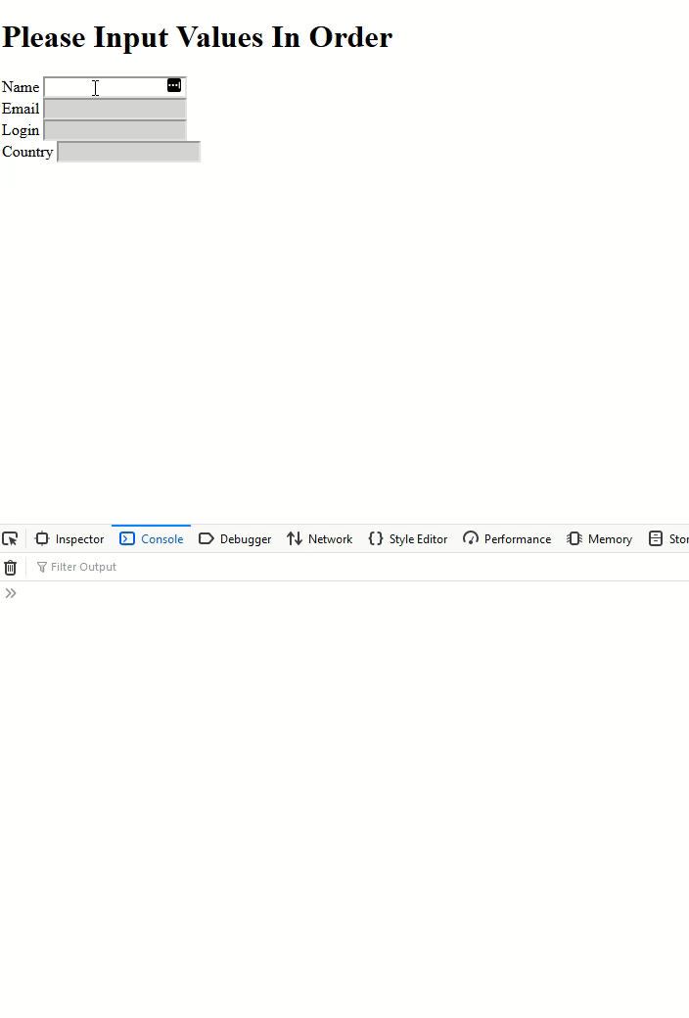
Use Case: Context Sensitive Form
Form elements are disabled until after user input
Toggle state of next inputs based on event

Slide 3
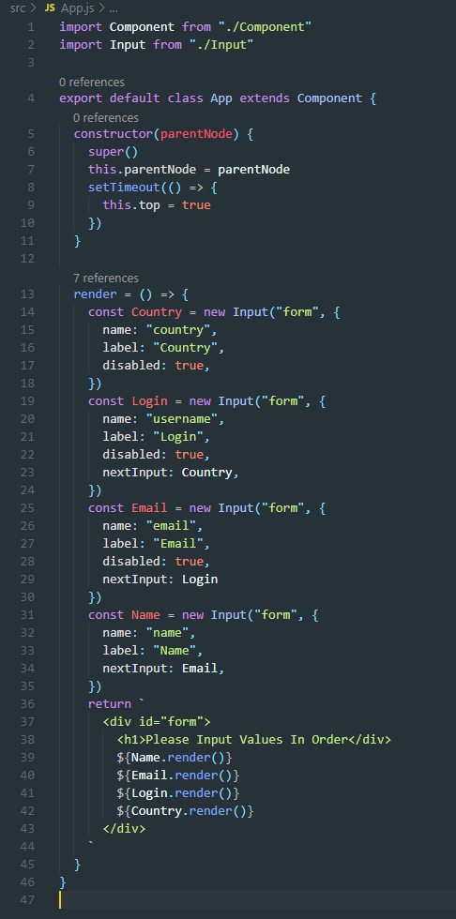

Slide 4
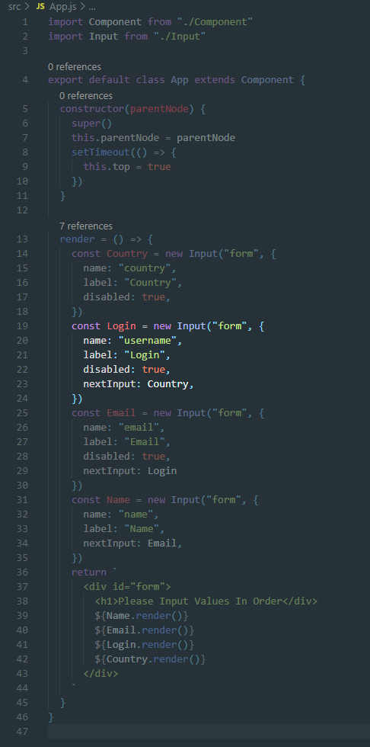

Slide 5
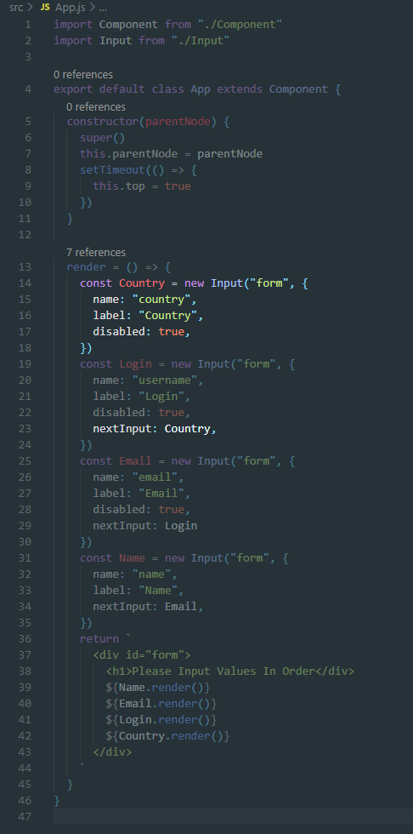

Slide 6
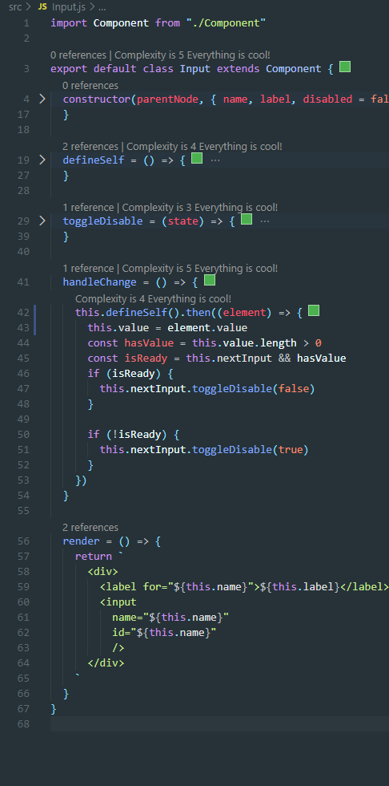

Slide 7
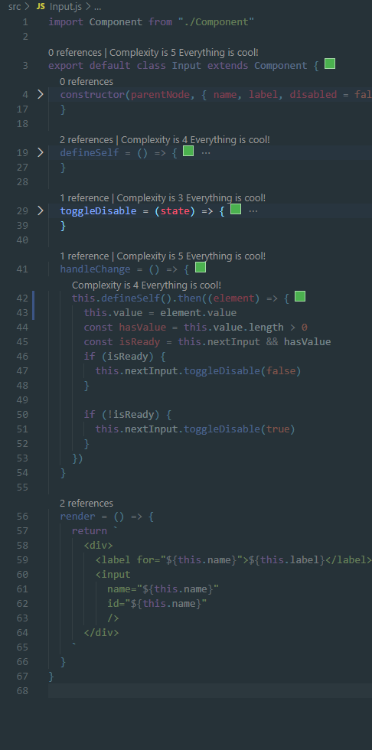

Slide 8
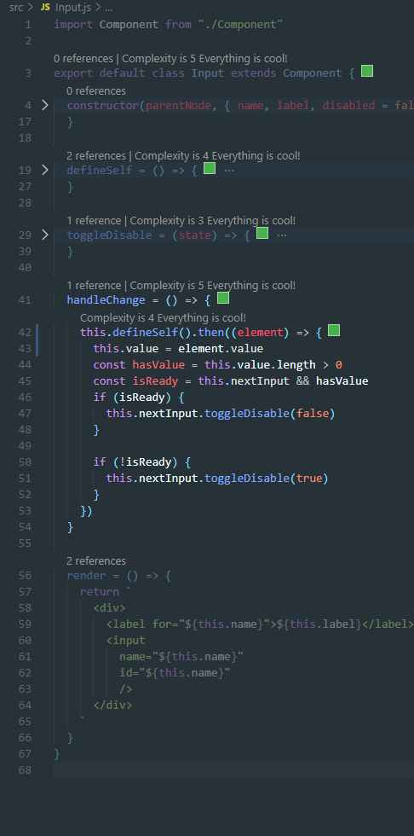

Slide 9
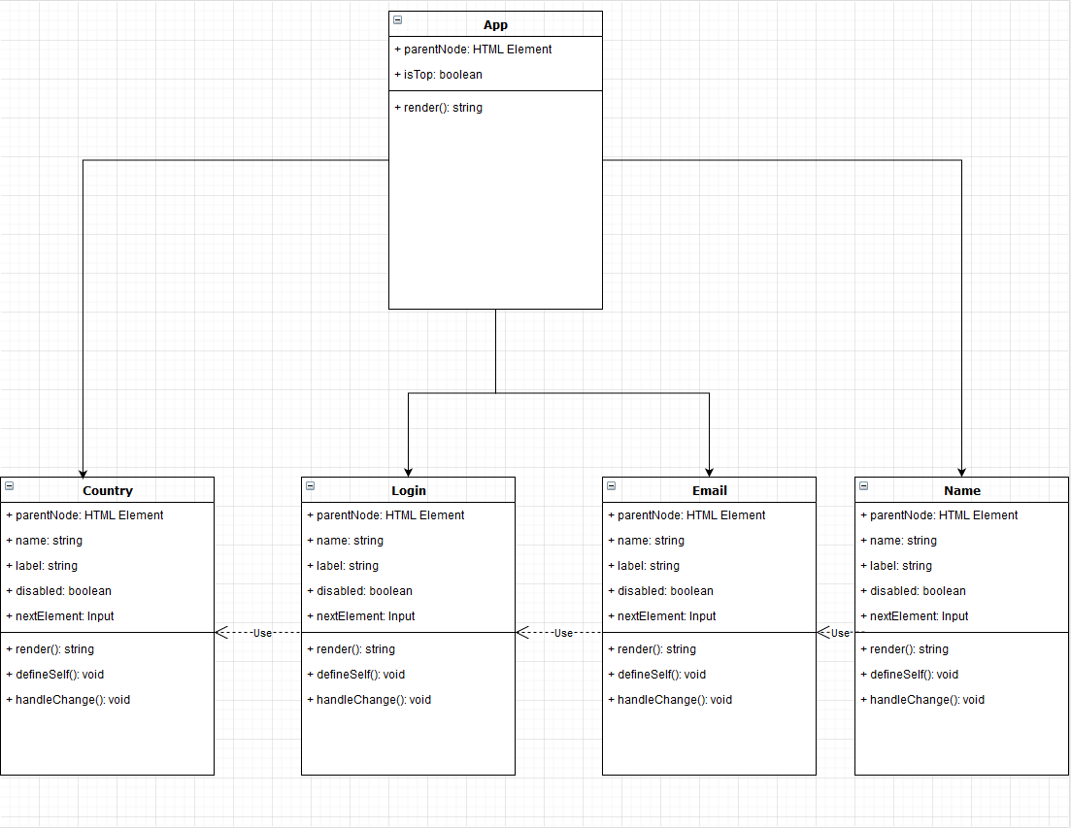

Slide 10
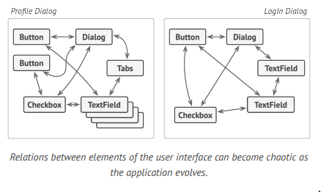
What’s Happening
Input objects are modifying state in two areas
Its own value state
Its sibling’s disabled state
Violates SOLID design principles
Open/Closed
Single Responsibility
Developer challenges
Reusability
Maintainability
Readability

Slide 11
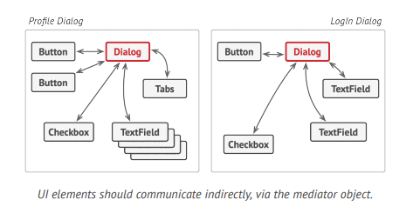
Mediator Design Pattern
Parent Object Controls View State
Provides dispatch events to children
Children invoke the dispatcher to update view
Parent updates children via their interfaces

Slide 12
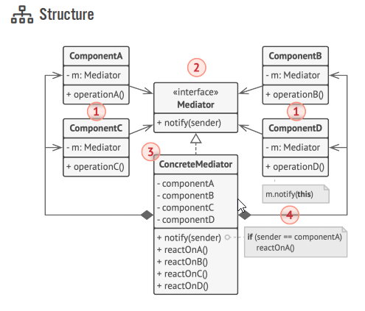
Mediator Design Pattern
Each child component is instantiated with a reference to its parent (Mediator)
Each child’s operation method invokes the parent’s dispatch event (notify)
The mediator can determine which component updated state and react accordingly.

Slide 13
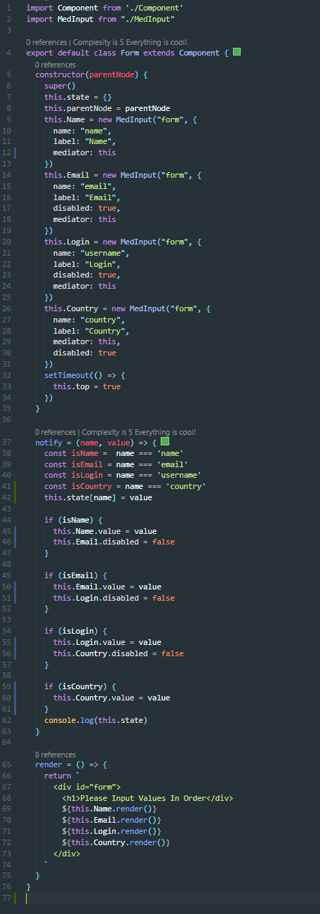

Slide 14
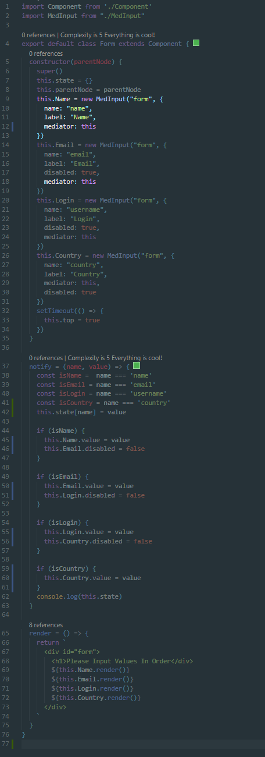

Slide 15
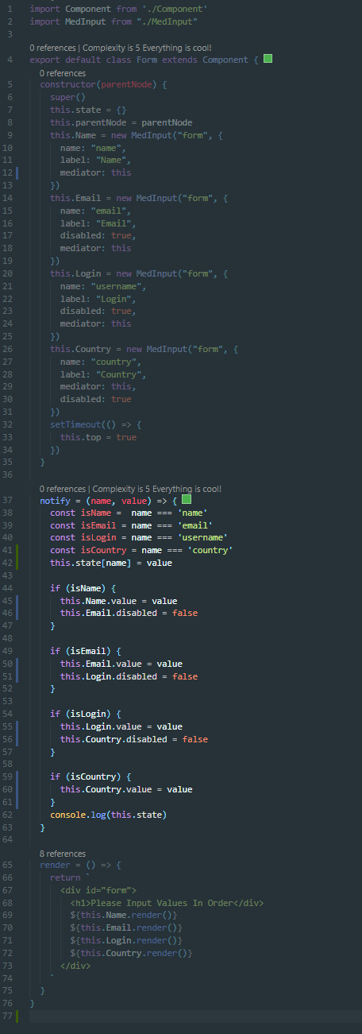

Slide 16
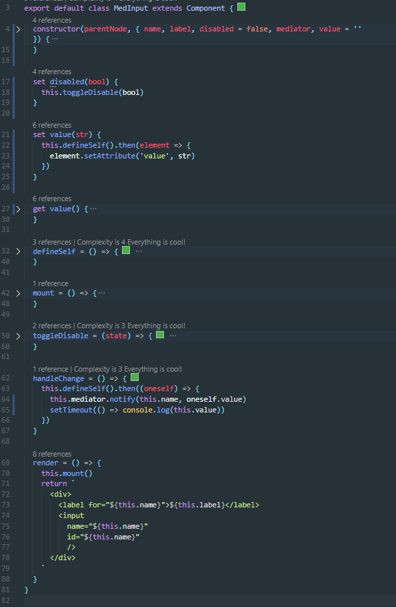

Slide 17
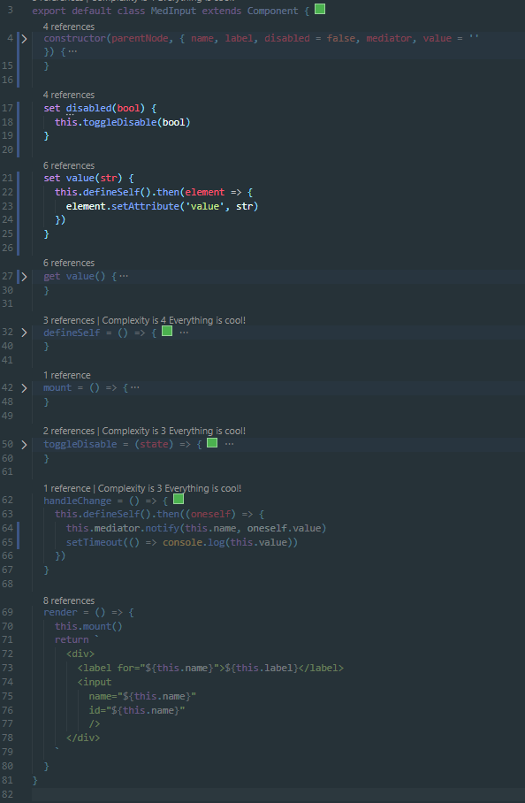

Slide 18




When to Use: Likely Never
The JS example is for demonstration purposes
Modern JS frameworks provide abstractions based on this pattern

Slide 19




When to use: Likely Never
Modern UI Frameworks
Web
React (JS)
Vue (JS)
Vaadin (Java)
Blazor (C#)
Native
Swift UI (Swift)
Flutter (Dart)
Jetpapck Compose (Java)

Slide 20


However…
The pitfalls this pattern address can exist
Global state libraries/tools
Child components containing ancestor state/methods

Slide 21
Conclusion / Open Floor
Main takeaway
Most beneficial in a tree of objects
Prevents leaves from violating SOLID principles
Modern UI libraries and frameworks have this pattern baked-in
However, global state tools can recreate the same issue this pattern was made to solve

